Slide 1
EST. 1995

Slide 2
ABOUT US
Moosehead was built off the blood, sweat, and tears of owner Dave George. Starting in 1995 Moosehead opened its doors for business in Vermilion, Ohio. Striving to be the best owner Dave went to BBQ rib competitions all over the country sampling the different styles of BBQ. Dave took what he learned and tasted back to his shop and developed a recipe that will make you keep coming back for more. Dave took the recipe along with friends and family to rib competitions and won what he already knew was true, BEST DAMN RIBS IN CLEVELAND.
We look forward to serving you!!

Slide 3
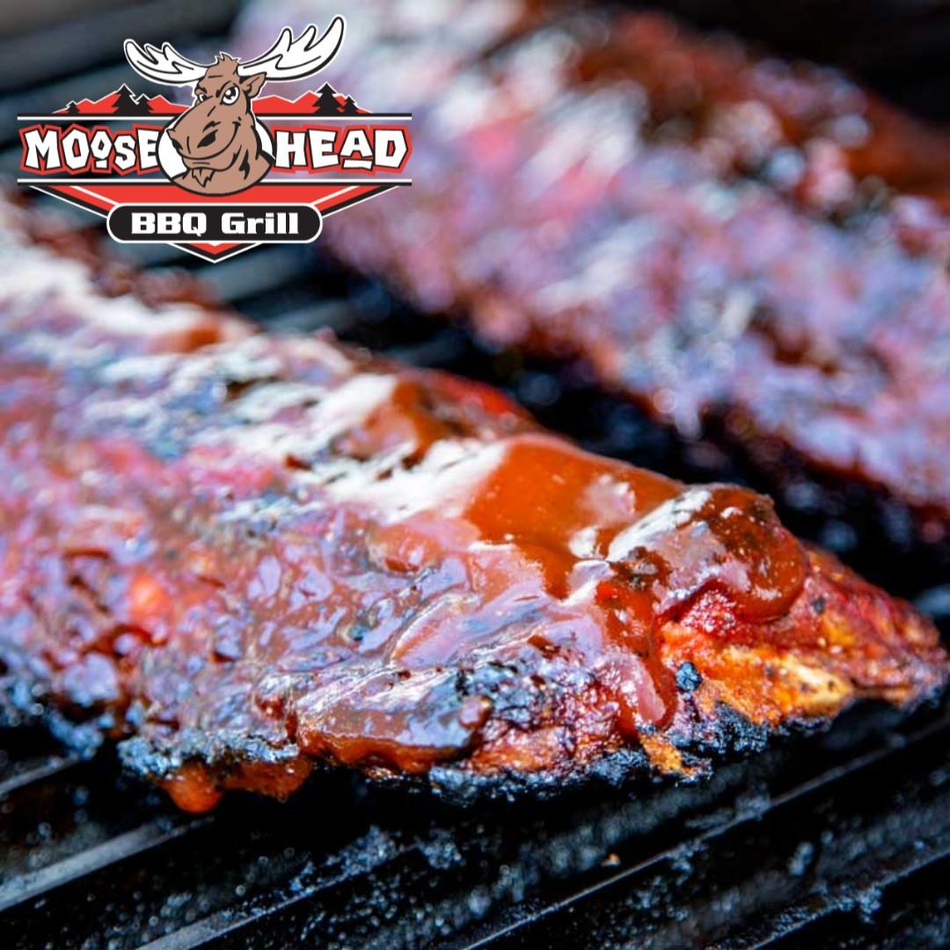
AWARD WINNING BBQ
All food is prepared fresh in house
Meats are smoked everyday and seafood is brought in fresh daily
We have the knowledge and “Award winning” recipes and systems to ensure your success!!
We have won 44 awards for our ribs and BBQ

Slide 4
AWARDS
People’s choice award – Cleveland Rib burn off
Best Barbeque – Lorain County 4 years running
Best Ribs – Strongsville Rib cook off
Best Sauce – Elyria Rib burn off
Best Ribs – Huron Rib cook off
This is only a small sample of our awards and trophies. We don’t have room to list them all but we appreciate every one of them!!!!

Slide 5
MENU ITEMS
Toasted Cheeseburger
Pulled Pork Sandwiches

Slide 6
MENU ITEMS
BBQ Grilled Salmon
Brisket Fajitas

Slide 7
CATERING
Your place or ours, we offer a full catering operation to help make your business a success!! Corporate parties, graduations, birthdays, we have what the consumer wants and demands in todays market!!!

Slide 8
ADDITIONAL REVENUE STREAMS
Moosehead offers additional revenue streams by allowing our franchisees to serve whole Turkeys, Hams and Chicken for the holidays or special orders. Amazing catering potential!!!!

Slide 9
FRANCHISE OPTIONS
Full Bar
Self-Serv. Beer wall

Slide 10
ESTIMATED COST PER LOCATION
Cost per location | Moosehead BBQ
Franchise Fee | $35,000
Lease Deposit | $10,000 - 2 months’ rent
Leasehold Improvements | $25,000 - $75,000
Equipment/Furniture | $50,000 - $99,000
Signage | $8,000
Utilities, Ins., Licenses | $7,000
Opening Inventory | $20,000
Grand Opening Promos | $8,000
Total Amount | $163,000 - $262,000
Working Capital | $10,000
Est. Total | $173,000 -$272,000

Slide 11
FORECAST & BUSINESS MODEL

Slide 12
CONTACT US FOR MORE DETAILS
Scott Hagg – Clevelandbrandconcepts@gmail.com

